Slide 1

SMART CITIES
L6 3.4.2017
Spring Semester 2017, ETH Zürich
Gerhard Schmitt

Slide 2
Definitions
Context
3 GS: Urban Big Data
4 GS ET: Urban Measurement
5 GS: Urban Science
6 GS: Complexity Science
Exercise 2: Urban Measurement
Exercise 1: QUA-KIT
Citizen Design Science
Measurement and Simulation
Stocks and Flows in Urban Systems
Participatory Design and Management
8 GS: Smart Livability
Objectives, Definition, MOOC
Smart Cities
10 GS: From smart cities to responsive cities
1 GS ET: Introduction
7 GS: Smart Governance
Exercise 3:
QUA-KIT
Complexity Science
City Livability Rankings
From smart cities to responsive cities
Final presentation on MOOC discussion topics
Smart Objects, Smart Buildings, Smart Cities

Slide 3
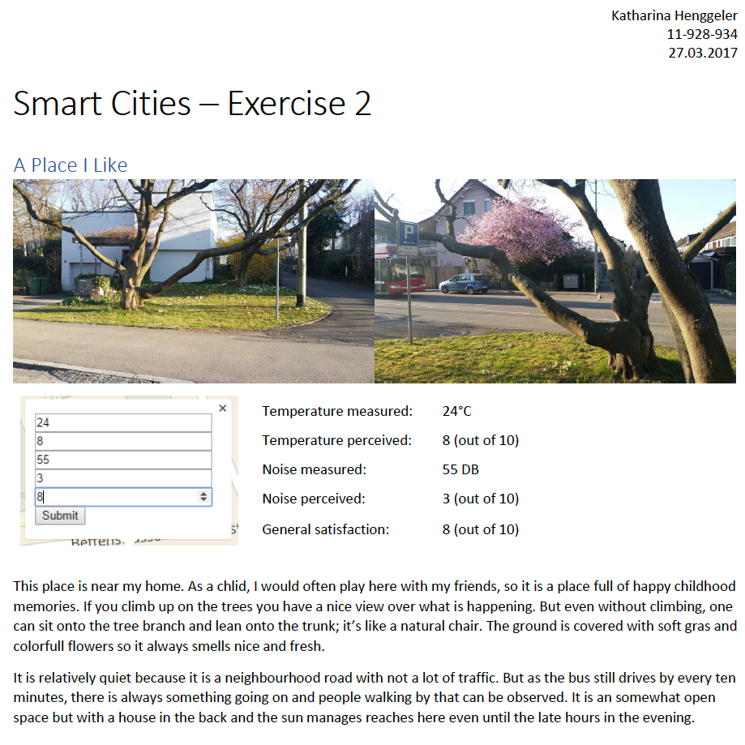

Slide 4
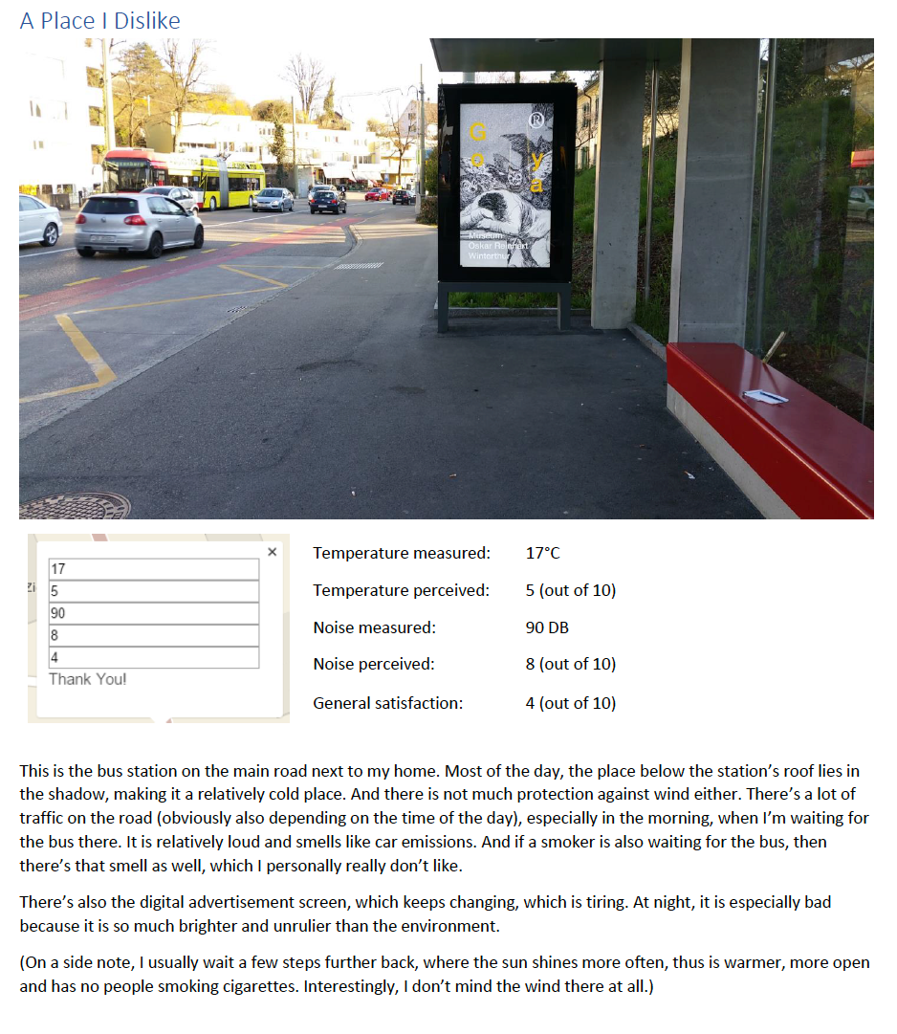

Slide 5
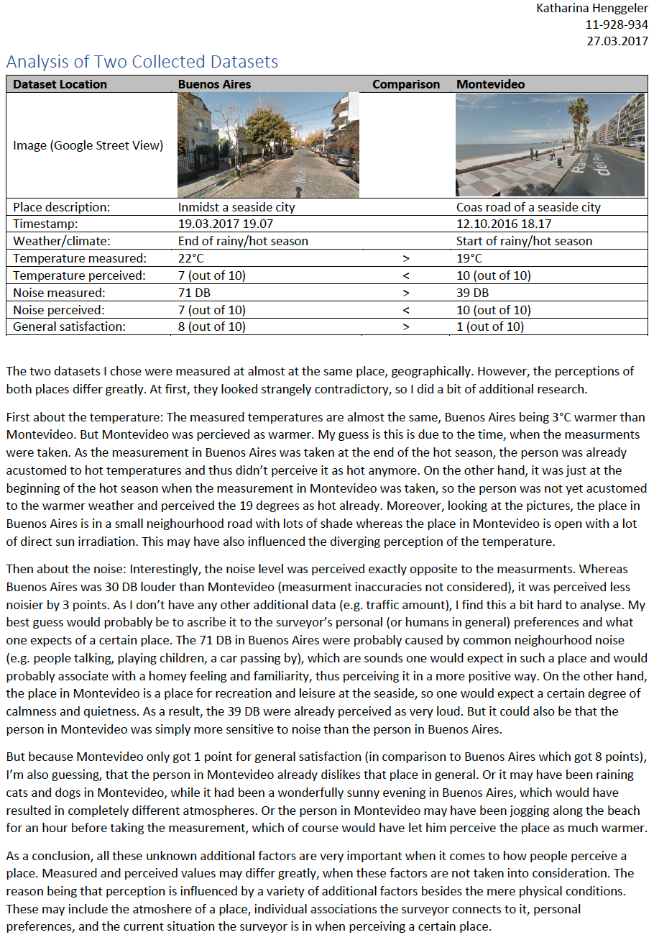

Slide 6
The story so far:
3.4.2017 Complexity Science as explanantion for Smart City growth
27.3.2017 Citizen Design Science as a future urban development method
13.3.2017 Can you improve what you do not measure?
6.3.2017 Big Data as new urban raw material, made useful with Information Architecture and with the Stocks and Flows concept
27.2.2017 From smart houses to smart cities – emerging criteria for smart cities as urban systems
20.2.2017 Cities are complex systems. Ideally, they are sustainable, resilient, livable, smart, and finally responsive – from production machines to human habitat
Notes:
Reducing urban heat islands and transportation problems in tropical cities - examples from Singapore, Indonesia and Ethiopia
Prof. Gerhard Schmitt, ETH Zürich
Abstract
Tropical cities suffer increasingly from the urban heat and pollution island effect as well as from transportation and mobility problems. The ETH Future Cities Laboratory at the Singapore-ETH Centre places these situations into a broader urban metabolism context and proposes integrated solutions. Urban planning and economics emerge as key factors, as demonstrated with case studies from Singapore, Indonesia and Ethiopia.
The stocks and flows of material and energy in a city reveal much more than numbers. They rather explain why certain cities heat up more than necessary and create uncomfortable conditions, especially in tropical areas. Striving towards cooler temperatures, the use of air conditioning in buildings and vehicles may reduce the local temperature, but may start a vicious circle in cities with little wind: the more we cool down buildings and cars, the more heat is released to the surrounding environment, resulting in higher temperatures that in turn need more cooling energy. In the end, all energy used is converted into heat.
The reduction of the transportation problem demands other measures than just increasing the number or capacity of streets and public transportation. Inspecting the roots of transportation and mobility demands in different countries, urban planning and zoning aspects emerge as most important ones. Separating living and working and not providing affordable housing in the vicinity of places where people work drastically increases demand for mobility, thus starting a vicious circle as well. The historical reasons for the separation, originating in the unhealthy living conditions in highly polluted European and American cities, make no longer sense for future sustainable and smart cities.
Both cases are related and can be turned into virtuous cycles. Necessary is the simulation of possible future scenarios, respecting and taking into account the interaction between the various stocks and flows of a city. The Future Cities Laboratory at the Singapore-ETH Centre for Global Environmental Sustainability has developed simulation and visualisation approaches for this purpose. Examples from Singapore, Jakarta and Ethiopia will demonstrate the potential benefit and their integration into urban planning, thus starting virtuous cycles of development.

Slide 7

Exercise 3

Slide 8
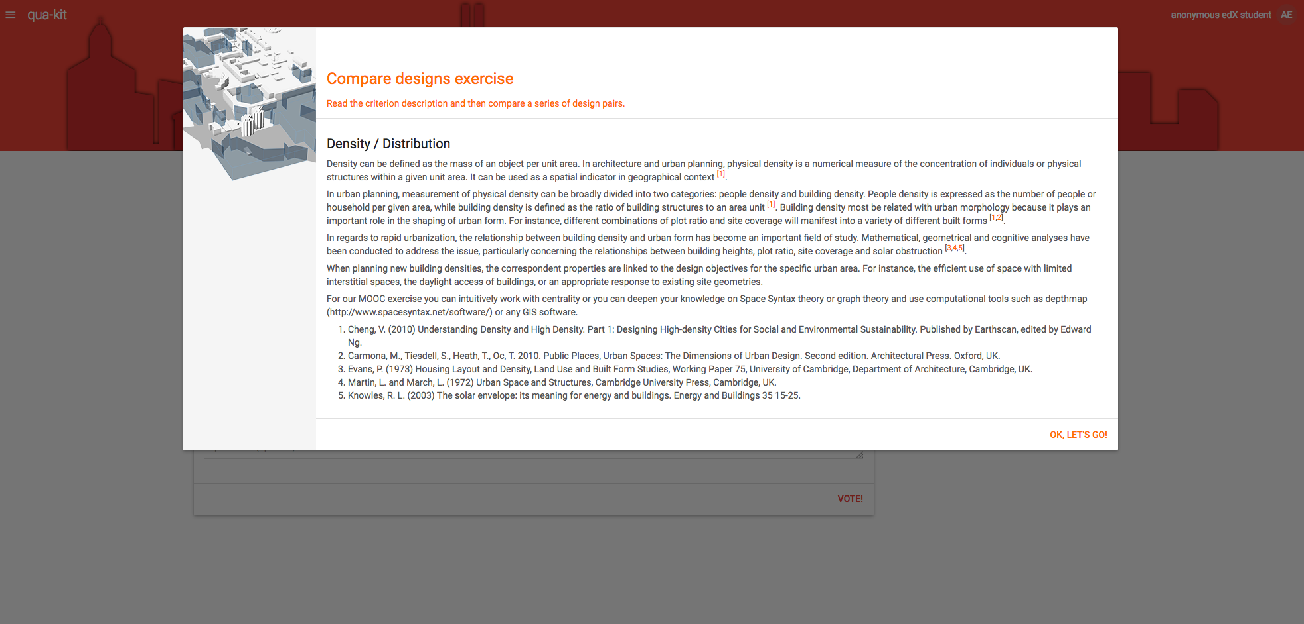

Slide 9
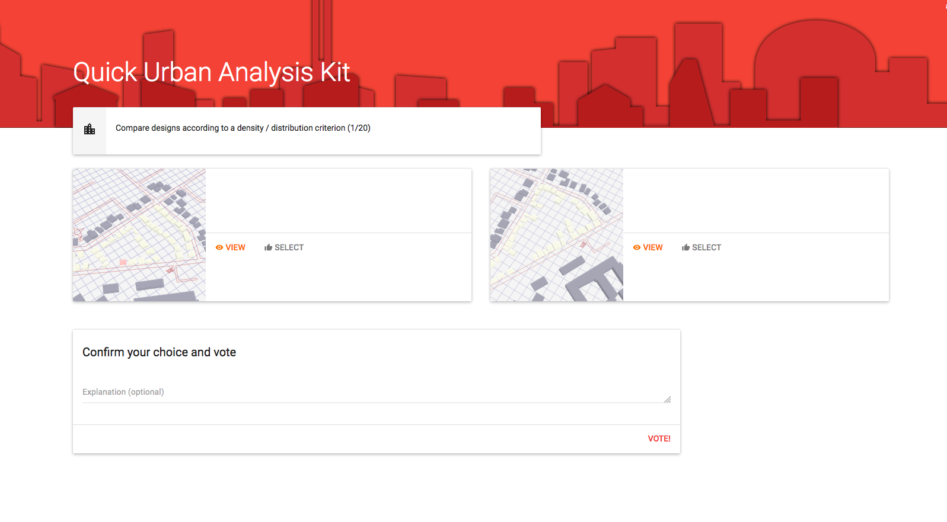

Slide 10
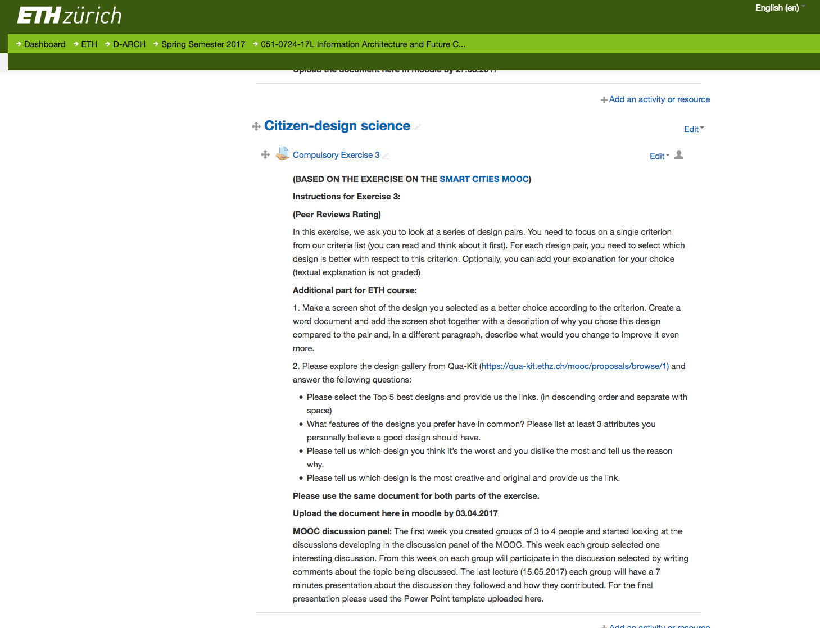

Slide 11
Exercise 3
2. Please explore the design gallery from Qua-Kit (https://qua-kit.ethz.ch/mooc/proposals/browse/1) and answer the following questions:
Please select the Top 5 best designs and provide us the links. (in descending order and separate with space)
What features of the designs you prefer have in common? Please list at least 3 attributes you personally believe a good design should have.
Please tell us which design you think it’s the worst and you dislike the most and tell us the reason why.
Please tell us which design is the most creative and original and provide us the link.

Slide 12
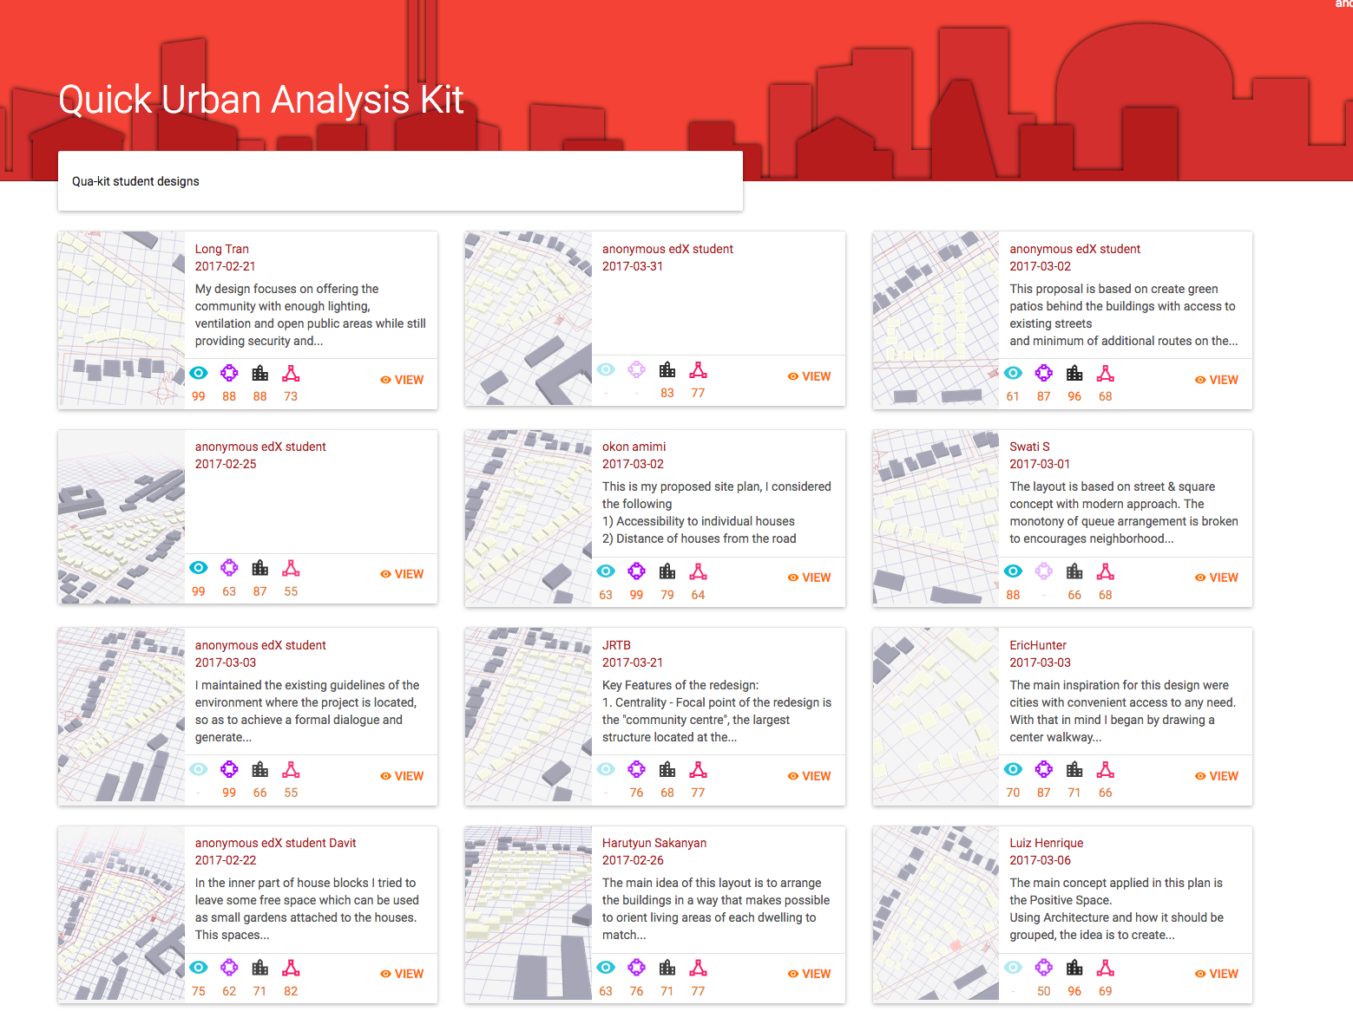
Exercise 3

Slide 13
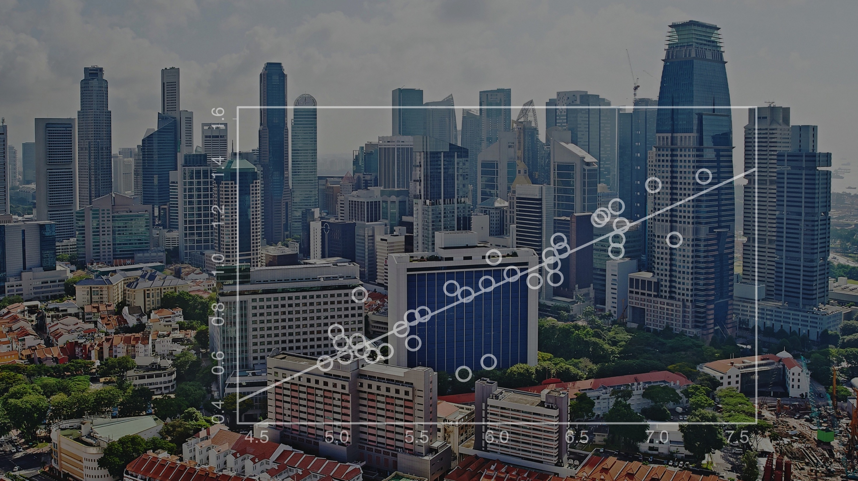
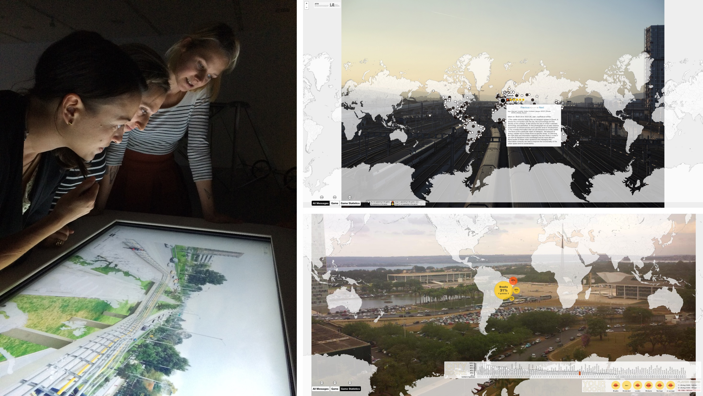

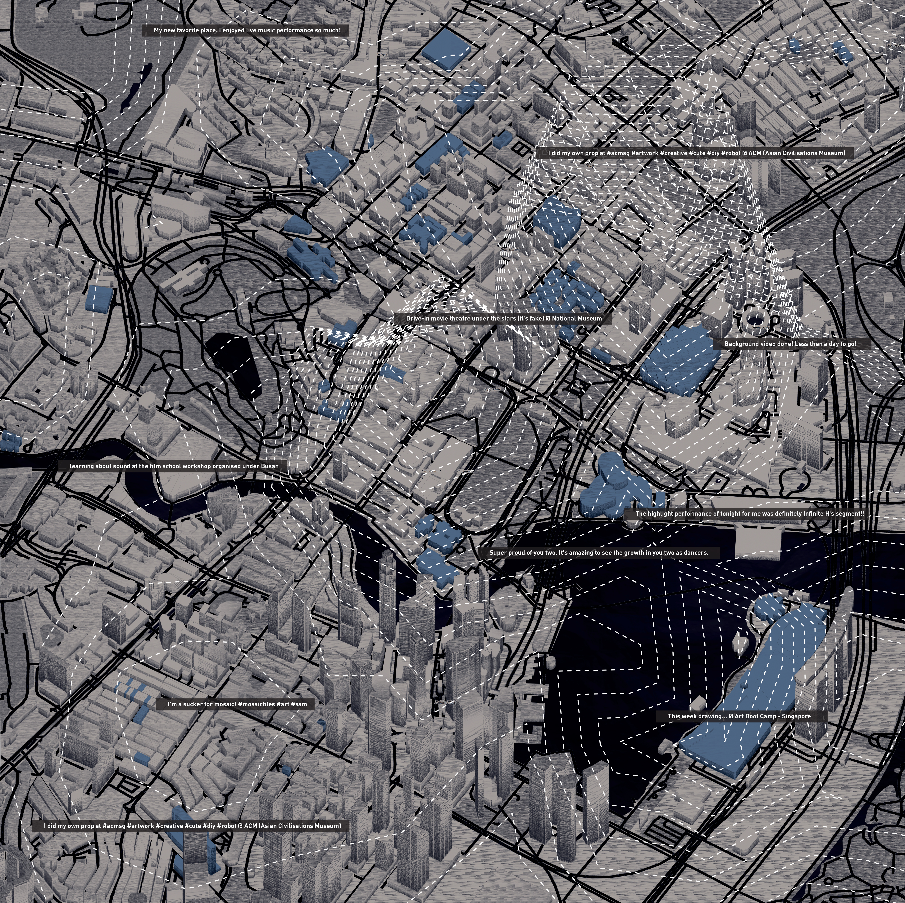

Challenges
Progress and Outcome
Urban Complexity
“Can we find hidden universalities in the dynamics of cities to predict future urban developments?”
Citizen Design Science
“How can we actively involve citizens to improve planning through the wisdom of the crowd?”
Cognitive Design Computing
“How can we combine the cognitive capabilities of humans with the computing power of machines?”
Evidence Informed Urban Design & Planning
“How can we integrate big data, user preferences, and designer knowledge for urban design and planning support?”

Slide 14
BigData-informed Urban Design and Governance
Urban Complexity
Understanding the interplay of Waterfront Tanjong Pagar with the overall organization of the city-state Singapore (e.g. in terms of people flows).
Left. Number of mobile phones per cell.
Source: Schläpfer (2017)
Right. Plot of functional form.
Source: Schläpfer, Szell, Ratti, West (in preparation)

Slide 15
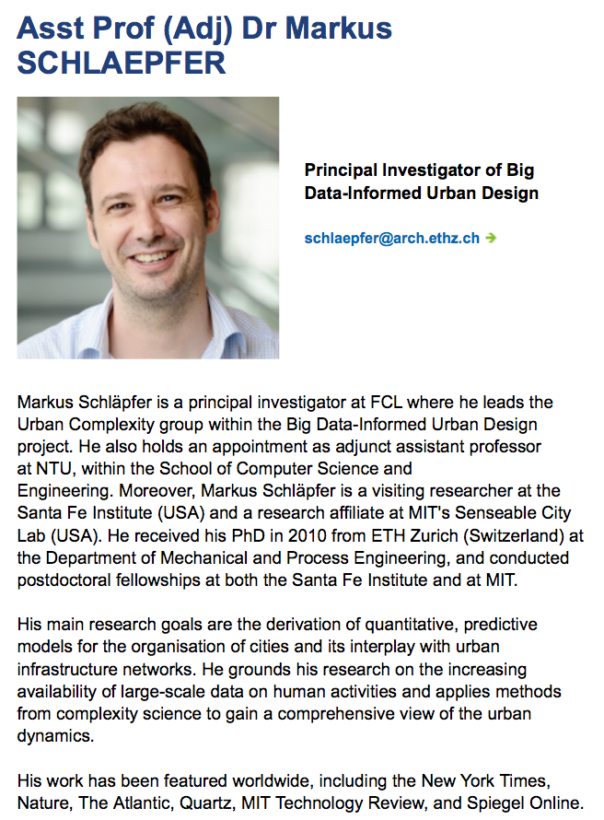

Slide 16
Exercises
Exercise 2: Measuring - Examples
Exercise 3: Introduction
Notes:
Reducing urban heat islands and transportation problems in tropical cities - examples from Singapore, Indonesia and Ethiopia
Prof. Gerhard Schmitt, ETH Zürich
Abstract
Tropical cities suffer increasingly from the urban heat and pollution island effect as well as from transportation and mobility problems. The ETH Future Cities Laboratory at the Singapore-ETH Centre places these situations into a broader urban metabolism context and proposes integrated solutions. Urban planning and economics emerge as key factors, as demonstrated with case studies from Singapore, Indonesia and Ethiopia.
The stocks and flows of material and energy in a city reveal much more than numbers. They rather explain why certain cities heat up more than necessary and create uncomfortable conditions, especially in tropical areas. Striving towards cooler temperatures, the use of air conditioning in buildings and vehicles may reduce the local temperature, but may start a vicious circle in cities with little wind: the more we cool down buildings and cars, the more heat is released to the surrounding environment, resulting in higher temperatures that in turn need more cooling energy. In the end, all energy used is converted into heat.
The reduction of the transportation problem demands other measures than just increasing the number or capacity of streets and public transportation. Inspecting the roots of transportation and mobility demands in different countries, urban planning and zoning aspects emerge as most important ones. Separating living and working and not providing affordable housing in the vicinity of places where people work drastically increases demand for mobility, thus starting a vicious circle as well. The historical reasons for the separation, originating in the unhealthy living conditions in highly polluted European and American cities, make no longer sense for future sustainable and smart cities.
Both cases are related and can be turned into virtuous cycles. Necessary is the simulation of possible future scenarios, respecting and taking into account the interaction between the various stocks and flows of a city. The Future Cities Laboratory at the Singapore-ETH Centre for Global Environmental Sustainability has developed simulation and visualisation approaches for this purpose. Examples from Singapore, Jakarta and Ethiopia will demonstrate the potential benefit and their integration into urban planning, thus starting virtuous cycles of development.

