Slide 1

SMART CITIES
Fall Semester 2016, ETH Zürich
Gerhard Schmitt

Slide 2
The story so far:
7.11.2016 Smart Urban Governance as success factor for future cities
31.10.2016 Citizen Design Science as a future urban development method
17.10.2016 Metrics of Smart Cities are basic instruments of urban research
10.10.2016 Stocks and Flows are fundamental concepts of urban dynamics
3.10.2016 Marc van der Net: Now Cities and Future Cities
25.9.2016 Cities are complex systems. Ideally, they are sustainable, resilient, livable, smart, and finally responsive – from production machines to human habitat. Smart Cities can be a step in this direction
Notes:
Reducing urban heat islands and transportation problems in tropical cities - examples from Singapore, Indonesia and Ethiopia
Prof. Gerhard Schmitt, ETH Zürich
Abstract
Tropical cities suffer increasingly from the urban heat and pollution island effect as well as from transportation and mobility problems. The ETH Future Cities Laboratory at the Singapore-ETH Centre places these situations into a broader urban metabolism context and proposes integrated solutions. Urban planning and economics emerge as key factors, as demonstrated with case studies from Singapore, Indonesia and Ethiopia.
The stocks and flows of material and energy in a city reveal much more than numbers. They rather explain why certain cities heat up more than necessary and create uncomfortable conditions, especially in tropical areas. Striving towards cooler temperatures, the use of air conditioning in buildings and vehicles may reduce the local temperature, but may start a vicious circle in cities with little wind: the more we cool down buildings and cars, the more heat is released to the surrounding environment, resulting in higher temperatures that in turn need more cooling energy. In the end, all energy used is converted into heat.
The reduction of the transportation problem demands other measures than just increasing the number or capacity of streets and public transportation. Inspecting the roots of transportation and mobility demands in different countries, urban planning and zoning aspects emerge as most important ones. Separating living and working and not providing affordable housing in the vicinity of places where people work drastically increases demand for mobility, thus starting a vicious circle as well. The historical reasons for the separation, originating in the unhealthy living conditions in highly polluted European and American cities, make no longer sense for future sustainable and smart cities.
Both cases are related and can be turned into virtuous cycles. Necessary is the simulation of possible future scenarios, respecting and taking into account the interaction between the various stocks and flows of a city. The Future Cities Laboratory at the Singapore-ETH Centre for Global Environmental Sustainability has developed simulation and visualisation approaches for this purpose. Examples from Singapore, Jakarta and Ethiopia will demonstrate the potential benefit and their integration into urban planning, thus starting virtuous cycles of development.

Slide 3
2 AC MvN: Smart Cities
3 GS: Urban Big Data
4 GS ET: Urban Measurement
5 GS: Urban Science
7 GS: Complexity Science
11 GS: Responsive Cities
Exercise 2: Urban Measurement
Exercise 1:
Smart Objects, Smart Buildings, Smart Cities
Citizen Design Science
Measurement and Simulation
Stocks and Flows in Urban Systems
Cognitive Design Computing
Participatory Design and Management
8 GS: Smart Livability
12 GS: Feedback Session
Objectives, Definition, MOOC
Smart Cities
9 GS: Smart Security
10 GS: Smart Mobility
1 GS ET: Introduction
6 GS: Smart Governance
Exercise 3:
Complexity Science
City Livability Rankings
Cyber Civil Infrastructure
Engaging Mobility
Next Steps

Slide 4
Content – Smart Governance
Governance – what is it and why is it important?
  MOOC and definitions
Organizations that need governance
  Lectures, universities, cities, countries
Urban Governance, inclusiveness and liveability
  From extraction to inclusion and back
Smart urban Governance and resulting changes
  Who will plan, manage and rule the city? Amsterdam 1600? Singapore 2016?
Outlook and conclusions

Slide 5
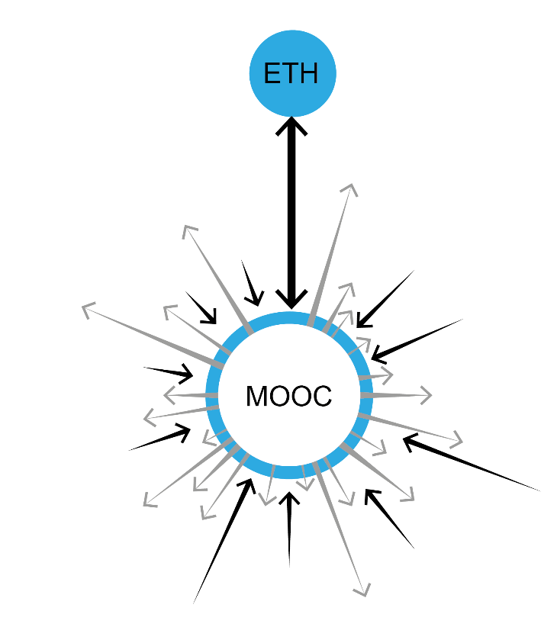
Liveable Cities

Slide 6
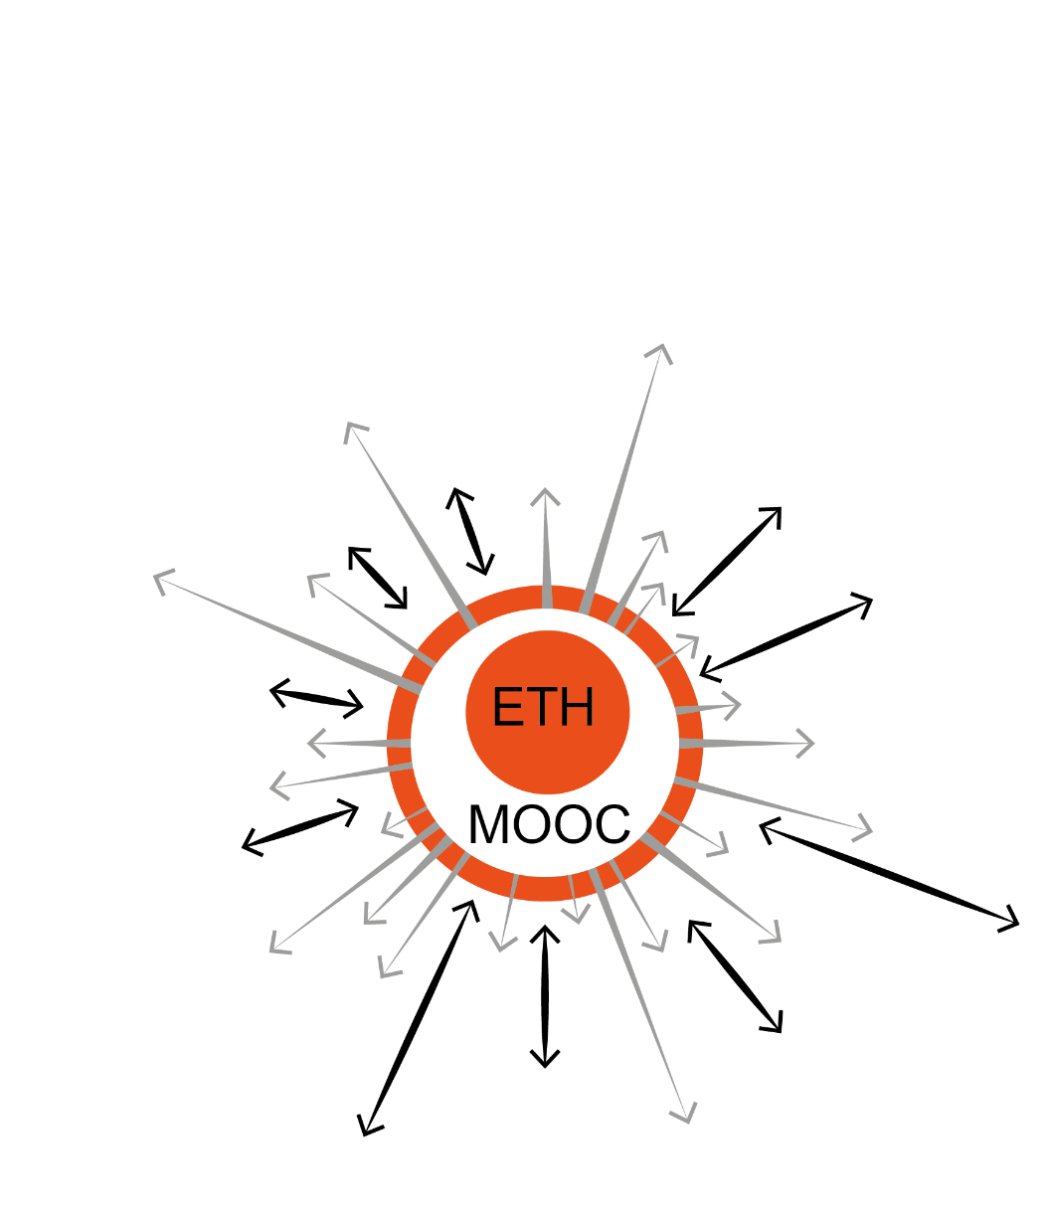
ETH Responsive Cities MOOC

Slide 7
Erfolgskontrolle: Planungs- und Controllingzyklus
Zielvereinbarung
mit ETH-Rat (4 Jahre)
Strategien und funk-
tionale Teilplanungen
(‚Inhalte‘)
Akademische
Planung
Professuren-
planung
Studierenden-
planung
Immobilien-
planung
ICT-
Planung
…
Rollende mittelfristige
Finanz(ierungs)planung
(‚Umsetzung‘)
MFP
2005-2008
MFP
2006-2009
Jährliche Ausgaben-
planung
Budgetierung
2004
Budgetierung
2005
Budgetierung
2006
Periodisches
Management
Reporting
Reporting
FY 2003
Reporting
Q1 2004
Reporting
Q2 2004
Reporting
Q3 2004
Reporting
FY 2004
Reporting
Q1 2005
Reporting
Q2 2005
Reporting
Q3 2005
…
Q1
Q2
Q3
Q4
Q1
Q2
Q3
Q4
Q1
Q2
Q3
Q4
2003
2004
2005
Peer Evaluationen
von Lehre & Forschung
ca. 2-3 Departemente
pro Jahr
Notes:
Planungsprozess
Teilplanungen (Akad./Prof./Stud./Immob./ICT):
festgehalten in: Mehrjahresplan (jeweils für die 4-jährige Planungsperiode)
abgestimmt mit: Zielvereinbarung ETH-Rat
Überführung von Strategien/Teilplanungen in mittelfristige Finanzplanung (rosa): via Rollende strategische Planung!
Jährliche Budgetierung auf Grund mittelfristiger Finanzplanung und rollender strategischer Planung/Professurenbesetzungsplanung.
Professurenbesetzungsplanung ist ein wesentlicher Veränderungsfaktor zwischen mittelfristiger Finanzplanung und jährlicher Budgetierung:
=> Zur Besetzung geplante Professuren können nicht besetzt werden, weil sich kein geeigneter Kandidat findet bzw. werden früher besetzt als geplant aus internen (z.B. tenure-track-Verfahren eines aP) oder externen Gründen (z.B. Direktberufung hot shot).
Controllingprozess:
Finanziell: Quartalweises Reporting der Einheiten in Bezug auf die zugeteilten Budgets (Grund- und Zusatzfinanzierung).
Inhaltlich: Evaluationen und Lehrevaluationen bei den Departementen; regelmässige Direktionsgespräche mit den IB.

Slide 8
Zuteilung der Mittel: Interne Budgetstruktur
Finanzierungsbeitrag
des Bundes
Einnahmen/
Gebühren
Drittmittel
Zuwendungen
Grundfinanzierung (ca. 90%)
Zusatzfinanzie-
rung (ca. 10%)
Grundauftrag
Departemente
Infra-
struktur
Schulleitung
Professuren
Schulleitung
Erbringung der Grundleistung:
Lehre und lehrbezogene Forschung/Grundversorgung/
Investitionen
Jährliche Zuteilung und eigenständige Bewirtschaftung durch die Einheiten
Kompetitive Verteilung und übergeordnete Vorhaben
Einwerbung und Bewirt-schaftung durch die Leistungs-träger
Übergeord-nete Vor-haben aus-serhalb des Leistungs-auftrags
Notes:
FBB + Einnahmen/Gebühren (2003: 966.4 mCHF):
Grundfinanzierung der Einheiten und Infrastruktur (90%) und Zusatzfinanzierung der Einheiten (10%).
Grundfinanzierung (Grundauftrag): Grundaufträge Dept. und IB sowie Investitionen (Bauen, Informatik, Mobilien/Einrichtungen)
Infrastruktur: = IB und Investitionen
Zusatzfinanzierung (Projekte): kompetitiv verteilte Mittel, ca. 100 Mio. (im wesentlichen: Forschungs- und Lehrprojekte, Berufungskredite etc.) sowie (nicht unbedingt kompetitiv): Antrittsfinanzierungen, Assistenzprofessuren, Überbrückungsstellen etc.
Drittmittel:
= Forschungsdrittmittel, kein direkter Einflussbereich der Schulleitung
Endowments: im Aufbau begriffen (Gründung ETH-Foundation).
Ziele:
Direkte Schenkungen
Ertrag aus Zinsen der Stiftung längerfristig ca. 50 mCHF jährlich

Slide 9
Zuteilung der Mittel: ETH Zürich – Oberbehörden

Slide 10
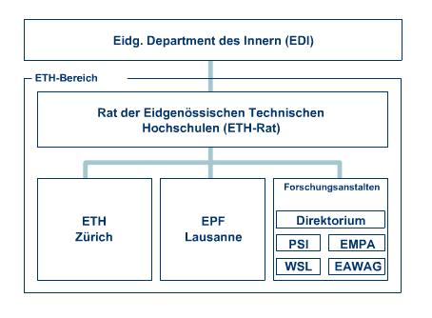
ETH – National Organization
Quelle: www.ethrat.ch

Slide 11
Urban Governance
„The exercise of political, economic and administrative authority in the management of a country’s affairs at all levels. Governance comprises the complex mechanisms, processes, and institutions through which citizens and groups articulate their interests, mediate their differences, and exercise their legal rights and obligations.
Good governance is among other things participatory, transparent and accountable. It is also effective and equitable and it promotes the rule of law. Good governance assures that political, social and economic priorities are based on broad consensus in society and that the voices of the poorest and the most vulnerable are heard in decision-making over the allocation of development resources.” http://www.un.org/millenniumgoals/pdf/Think%20Pieces/7_governance.pdf

Slide 12
Urban Governance
“Governance includes the state, but transcends it by taking in the private sector and civil society. The state creates a conducive political and legal environment. The private sector generates jobs and income. The civil society facilitates political and social interaction mobilizing groups to participate in economic, social and political activities. Because each has its weaknesses and strengths, a major objective of our support for good governance is to promote constructive interaction among all three.”
http://www.un.org/millenniumgoals/pdf/Think%20Pieces/7_governance.pdf

Slide 13
Urban Governance
“Good governance occurs when societal norms and practices empower and encourage people to take increasingly greater control over their own development in a manner that does not impinge upon the accepted rights of others”
UNDP Internet Conference Forum on
"Public Private Interface in Urban Environmental Management"

Slide 17
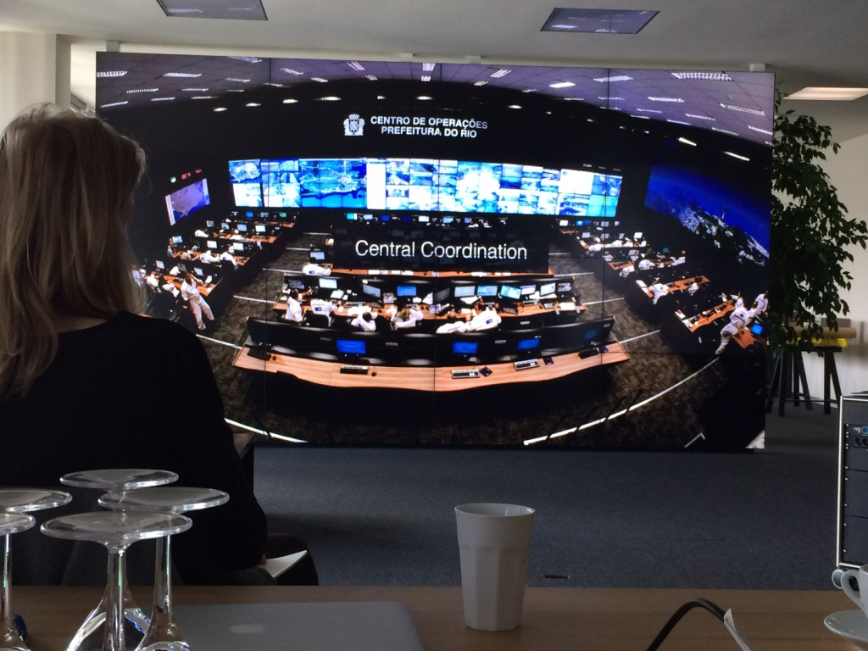

Slide 18
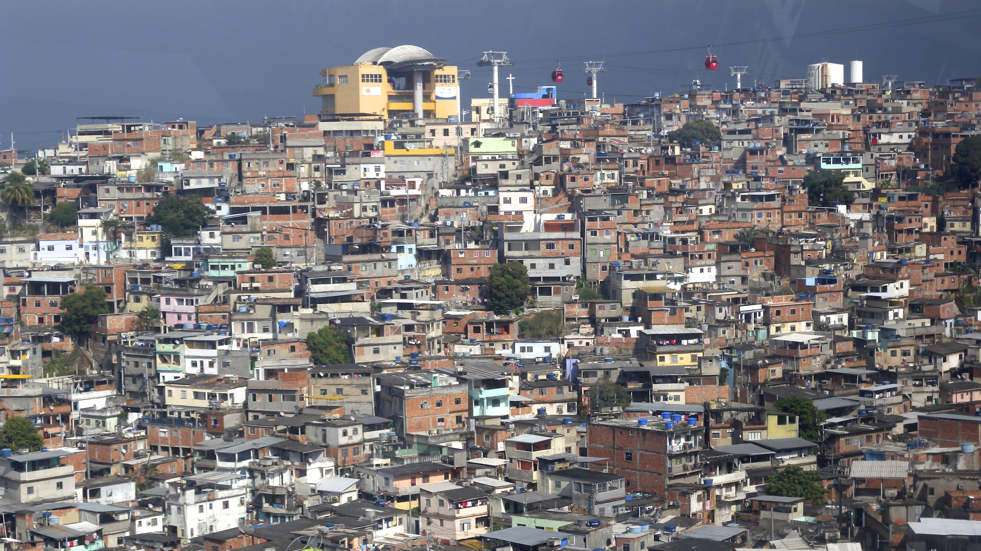
Citizen Design Science

Slide 19
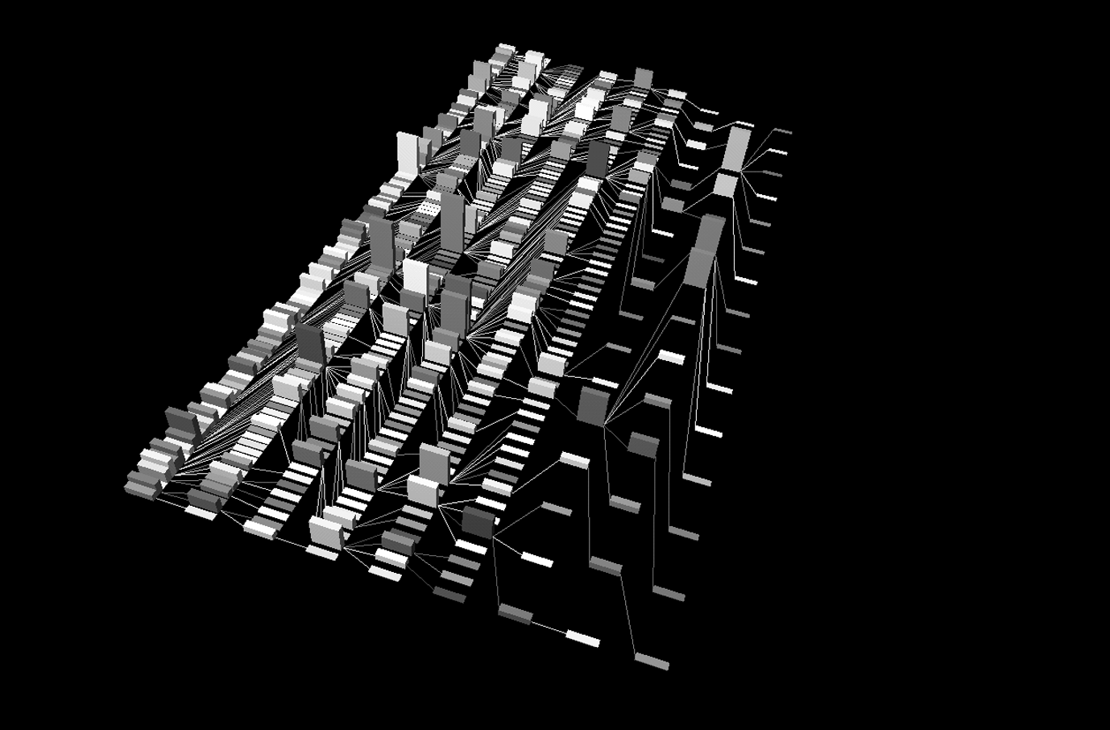
Collaborative Learning: Phase(X)
Phase(X)²

Slide 20
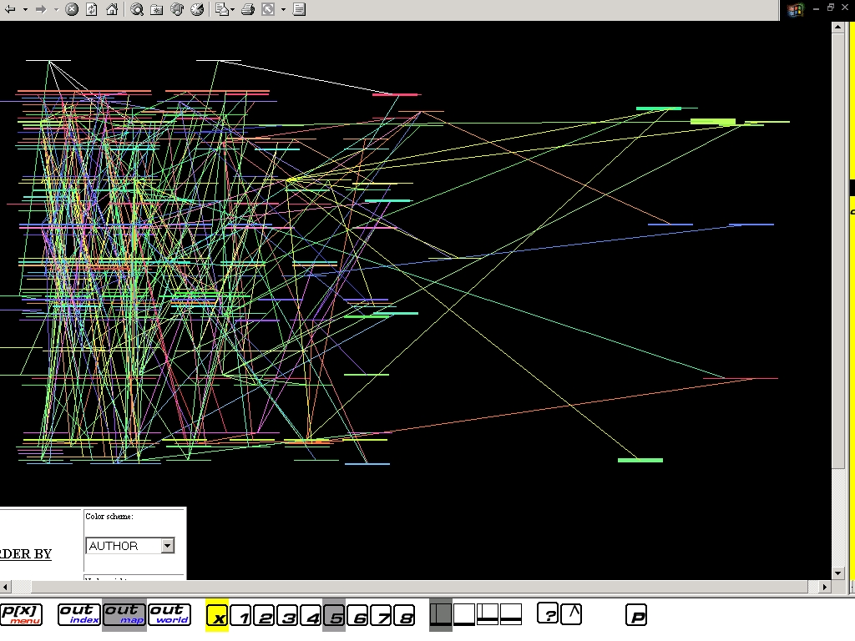

Slide 21
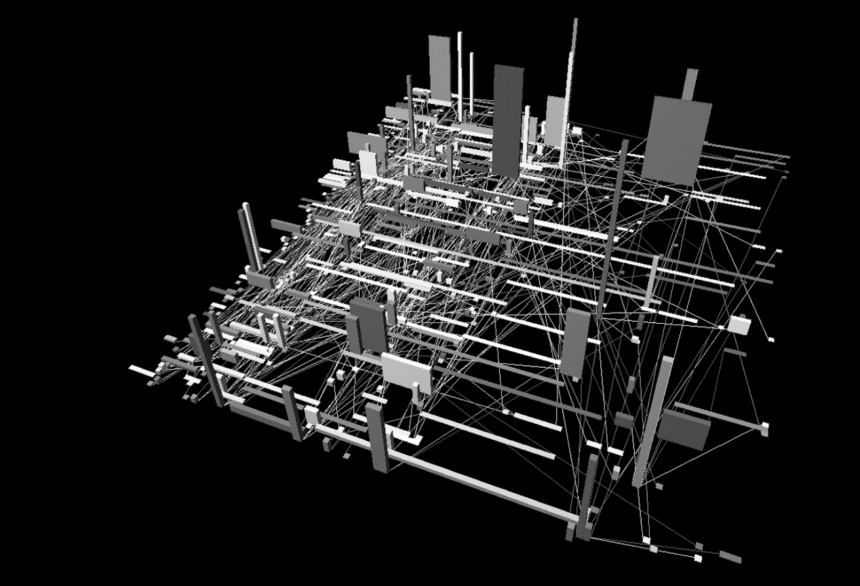
Phase(X)²

Slide 22
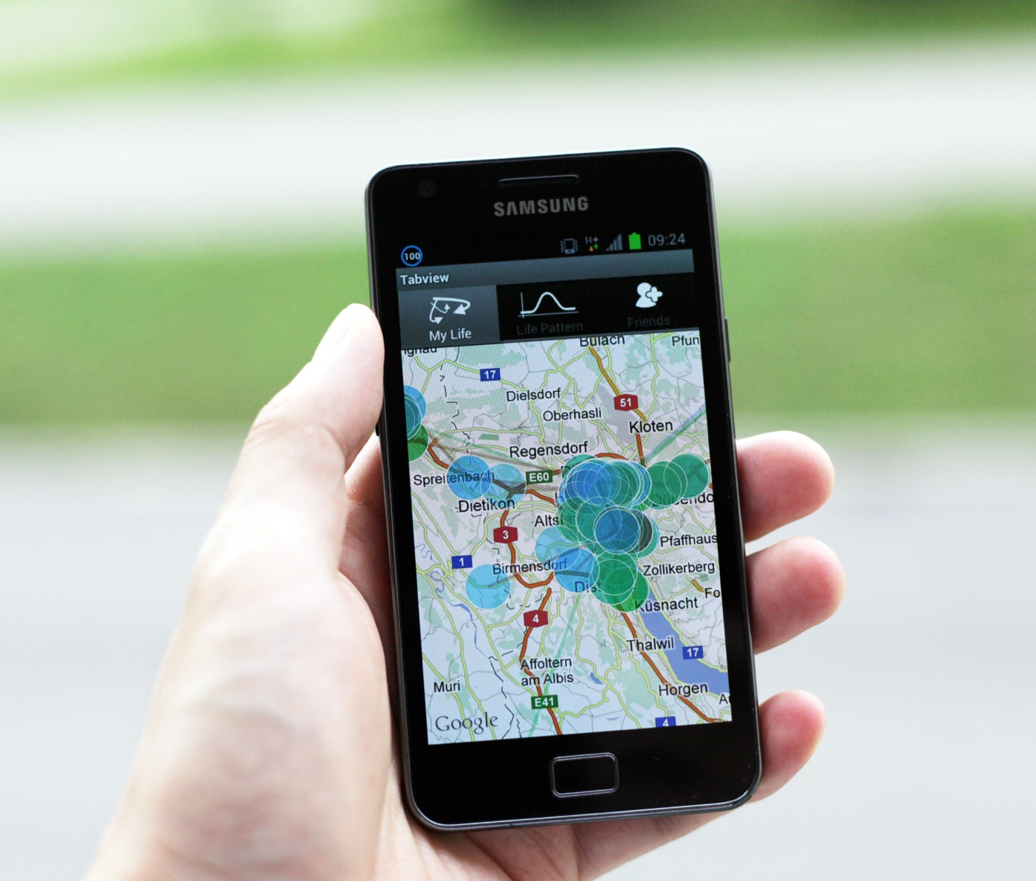
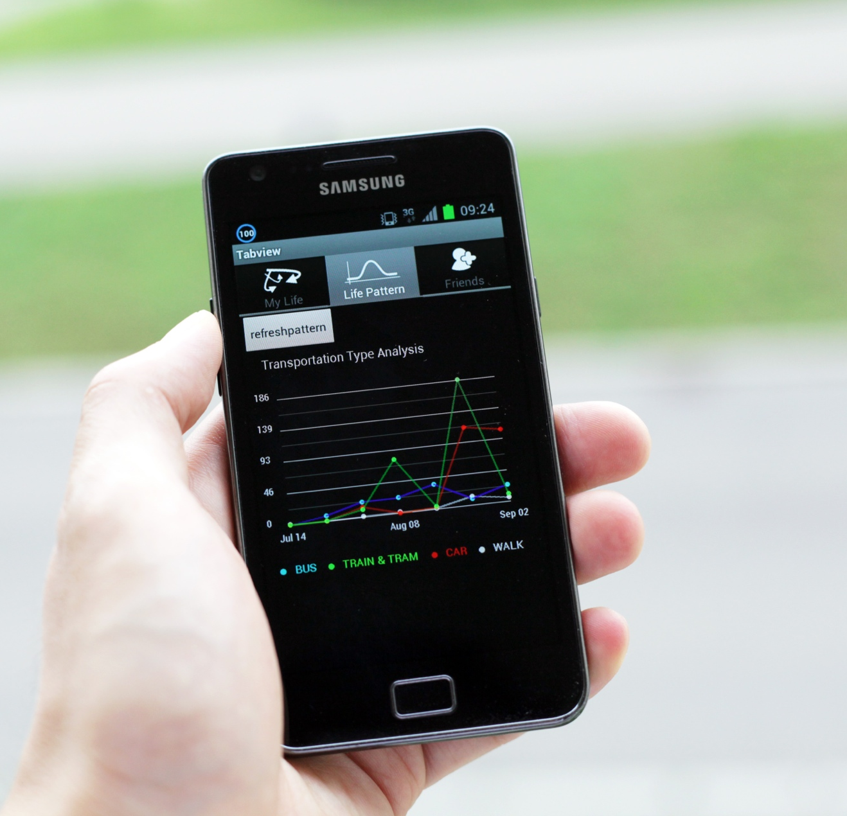

Mobile application: Citying, Dr Dongyoun SHIN

Slide 23
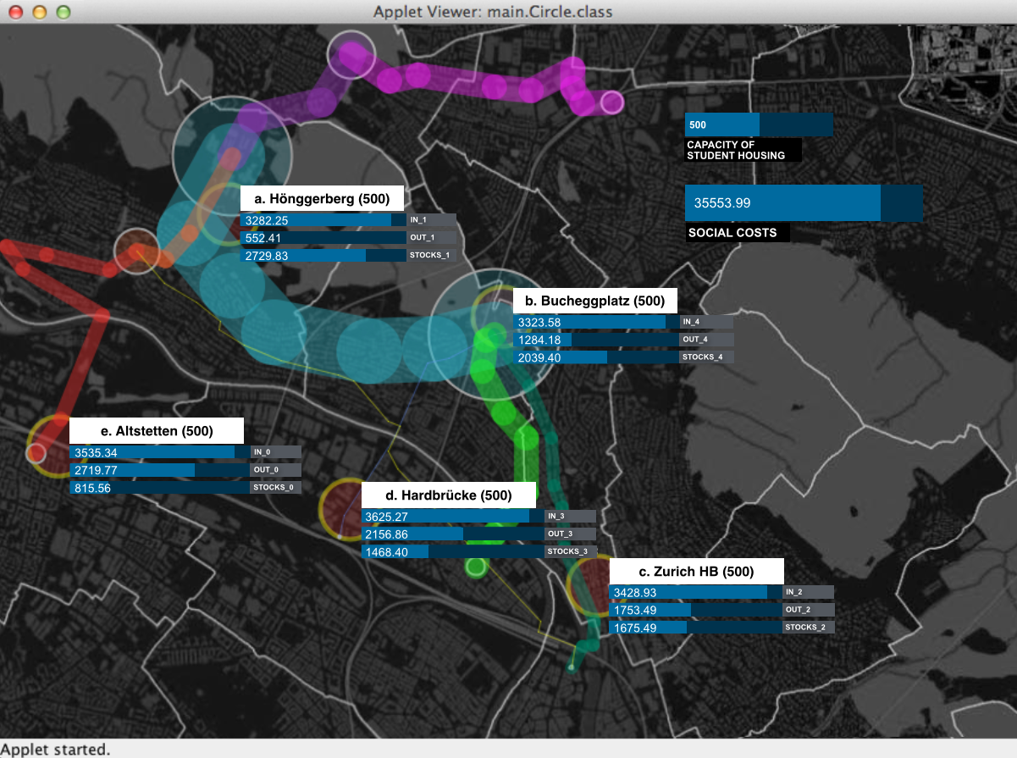
Social costs analysis: student housing
→ Weidmann 2004

Slide 24
http://www.pixelpromenade.com/de/tag/citizen-science/

Slide 25


INFORMATION ARCHITECTURE OF CITIES
QUA-KIT online tool
MOOC exercises
Information Architecture
Prof. Dr. Gerhard Schmitt
Notes:
Font: Arial
Please type name of module and presenter name(s) in the footer.
Topic XYZ etc. is the subtitle or the title of the slide.
There are four different design samples in this template.
Font size – Header = 14, Body text = 11, Source = 12 superscript

Slide 26
Exercise 1
Part 1
Exercise 2
Exercise 3
(Exercise 1, part 2)
 | DATE
COURSE | 12.09.2016 | 19.09.2016 | 26.09.2016 | 03.10.2016 | 10.10.2016 | 17.10.2016 | 24.10.2016 | 31.10.2016 | 07.11.2016 | 14.11.2016 | 21.11.2016 | 28.11.2016 | 05.12.2016 | 12.12.2016 | 12.12.2016
MOOC EDX | Week 1 Warm-up week | Week 2 Introduction to the course | Week 3 Smart cities | Week 4 Big data and stocks and flows of information | Week 5 Measurements and simulations in the city | Week 6 Citizen-design science | Week 7 Complexity science | Week 8 Smart Governance | Week 9 Smart Livability | Week 10 From smart cities to responsive cities | No MOOC | No MOOC | No MOOC | No MOOC | No MOOC
iA COURSE | No lecture | No lecture | Lecture 1 Introduction to the course | Lecture 2 Smart cities | Lecture 3 Big data and stocks and flows of information | Lecture 4 Measurements and simulations in the city | Seminar week | Lecture 5 Citizen-design science | Lecture 6 Smart Governance | Lecture 7 Complexity science | Lecture 8 Smart Livability | Lecture 9 Smart security | Lecture 10 Smart mobility | Lecture 11 From smart cities to responsive cities | Lecture 12
Preparation iA course |  | Send email to student to register for the MOOC Invite the LET people for a feedback session for the 9.05.2016 lecture | Part 1: Introduction to the course - explain exercises and create groups for MOOC panel discussions Part 2: Lecture by GS | Part 1: Presentation of QUA-KIT Online design proposals by students Part 2: Lecture by Mark van der Net (OSCity) | Part 2: Lecture by GS | Part 1: Presentation of QUA-KIT Online design proposals by students Part 2: Lecture by GS | Seminar week | Part 1: Presentation of Data collection app by students Part 2: Lecture by GS | Part 2: Guest lecture? | Part 1: Presentation of QUA-KIT Online design proposals by students Part 2: Guest lecture | Part 2: Lecture by GS | Part 2: Lecture by GS | Part 2: Lecture by GS | Part 2: Lecture by GS | Feedback session with students about the course dynamic and possible improvements for next Semester and MOOC. Invite the LET people
Excercises MOOC* |  | Week 2 QUA-KIT Online design tool |  |  | Week 5 Data collection app | Week 6 QUA-KIT Online design tool |  |  | Week 9 QUA-KIT Online design tool |  | No MOOC | No MOOC | No MOOC | No MOOC | No MOOC
Excercises iA course | No lecture | No lecture | Lecture 1 Introduction to the course Exercise: QUA-KIT Online design tool | No exercise | No exercise | Lecture 4 Measurements and simulations in the city Exercise: Data collection app | Seminar week | No exercise | Lecture 1 Introduction to the course Exercise: QUA-KIT Online design tool |  | No exercise |  | No exercise |  | Final presentation
Important dates – Hand in exercises:
03.10.2016 -> First proposal in QUA-KIT
31.10.2016 -> Data collection
21.11.2016 -> Comparing and rating designs in QUA-KIT
Please create a word document of your exercise and send it to:
schmitt@arch.ethz.ch
tapias@arch.ethz.ch

Slide 27
Exercise 3:
Go to ‘Smart Cities’ in the Edx platform and follow the instructions for Exercise 3.
Choose 3 of the designs you rated and explain your decision.
Propose and describe a tool (e.g. visibility analysis or temperature simulation tool) that can be used with Qua-Kit to support you to judge and rate these designs in the future.
Please create a word document of your exercise and send it to:
schmitt@arch.ethz.ch
tapias@arch.ethz.ch
Hand in exercise:
21.11.2016 -> Comparing and rating designs in QUA-KIT

Slide 28


Slide 29
Exercise 3:
Go to ‘Smart Cities’ in the Edx platform and follow the instructions for Exercise 3.
Choose 3 of the designs you rated and explain your decision.
Propose and describe a tool (e.g. visibility analysis or temperature simulation tool) that can be used with Qua-Kit to support you to judge and rate these designs in the future.
Please create a word document of your exercise and send it to:
schmitt@arch.ethz.ch
tapias@arch.ethz.ch
Hand in exercise:
21.11.2016 -> Comparing and rating designs in QUA-KIT

Slide 30
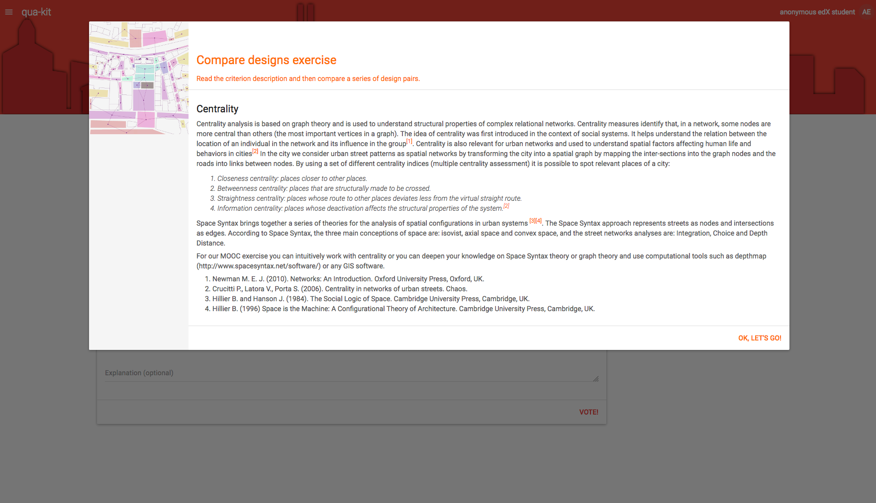

Slide 31
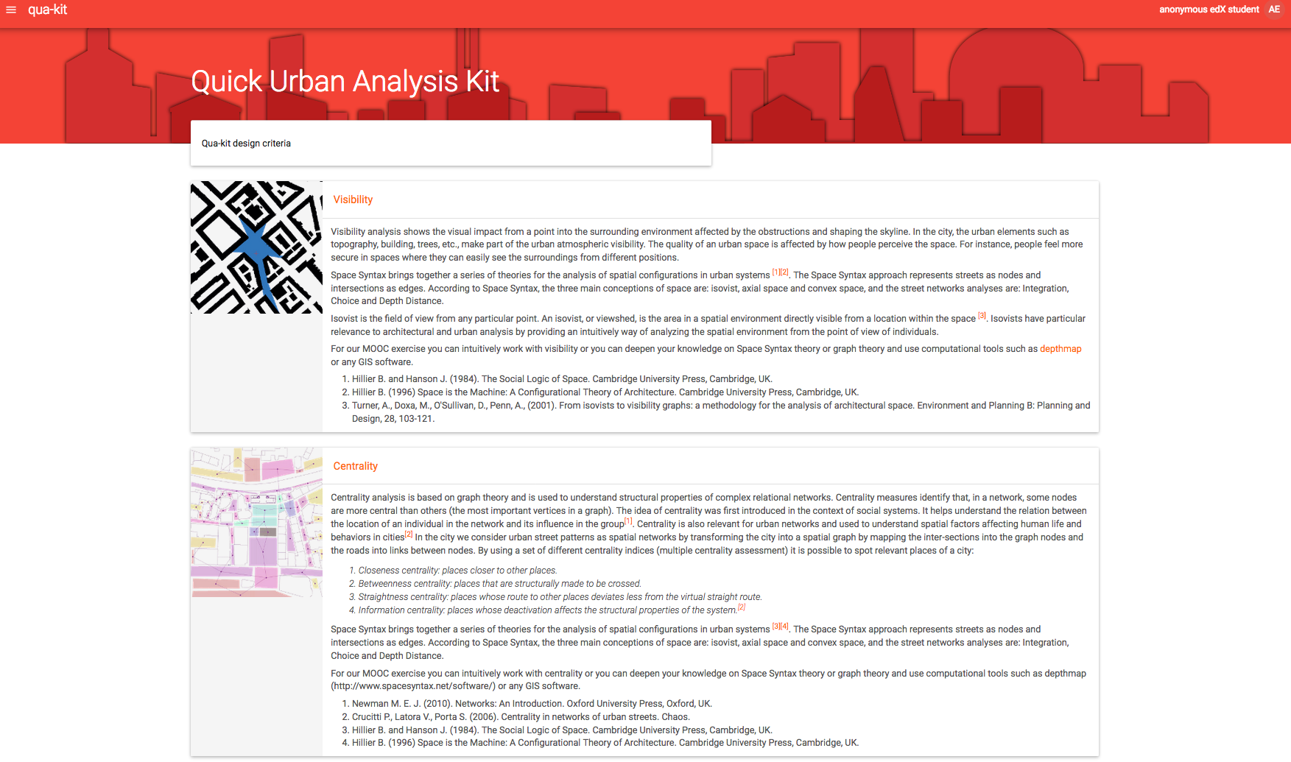

Slide 32
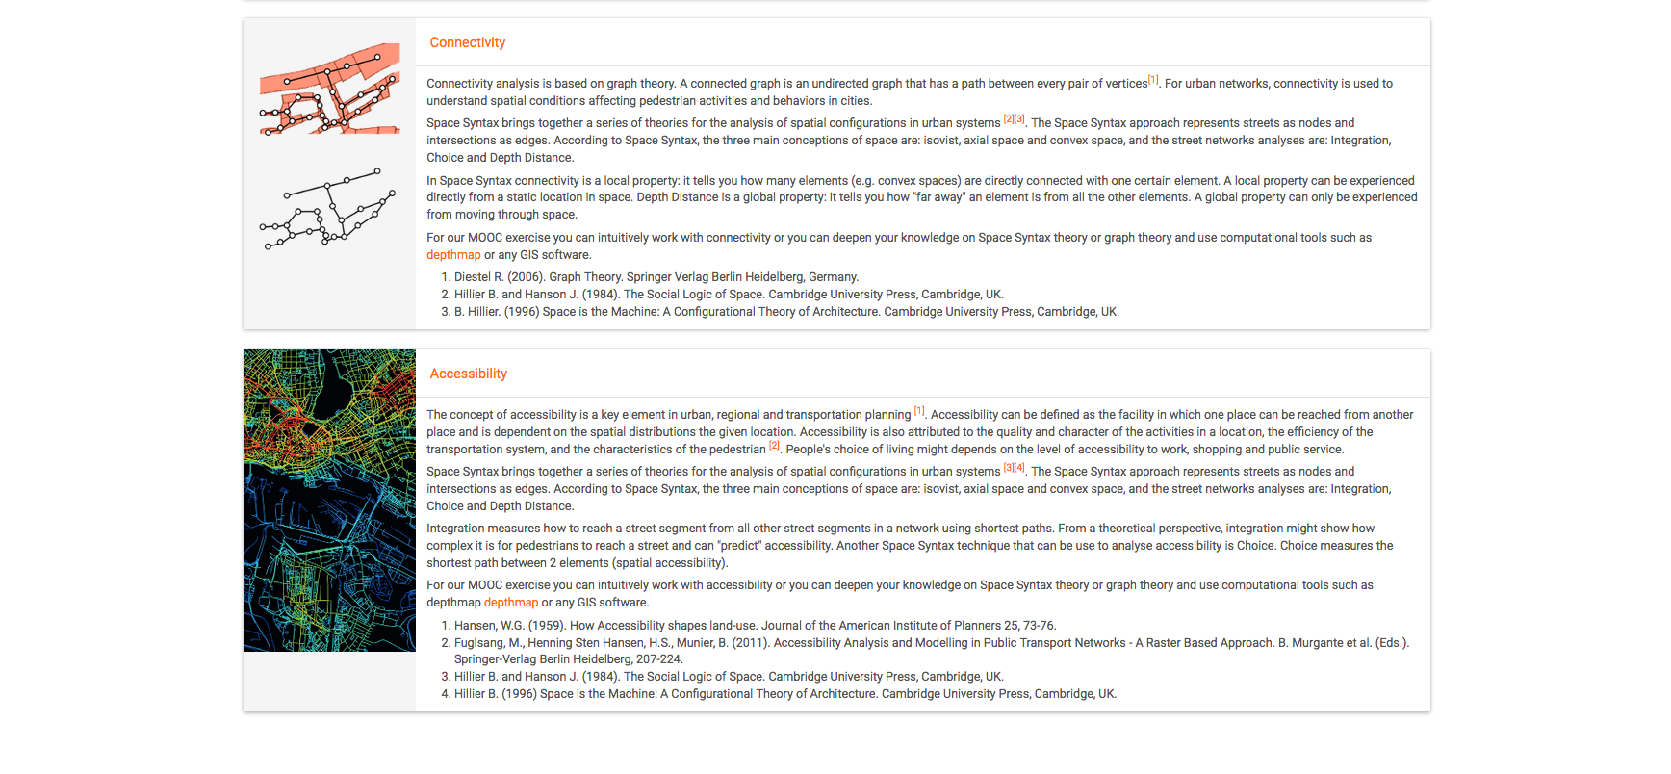

Slide 33
Exercise 3:
Go to ‘Smart Cities’ in the Edx platform and follow the instructions for Exercise 3.
Choose 3 of the designs you rated and explain your decision.
Propose and describe a tool (e.g. visibility analysis or temperature simulation tool) that can be used with Qua-Kit to support you to judge and rate these designs in the future.
Please create a word document of your exercise and send it to:
schmitt@arch.ethz.ch
tapias@arch.ethz.ch
Hand in exercise:
21.11.2016 -> Comparing and rating designs in QUA-KIT

Slide 34
Urban Governance
“"Governance" is the art of public leadership. There are three distinct dimensions of governance:
the form of political regime;
the process by which authority is exercised in the management of a country’s economic and social resources; and
the capacity of governments to design, formulate, and implement policies and discharge functions.
The criteria that constitute good governance have been drawn from these three dimensions, and include:
legitimacy of government (degree of "democratization"),
accountability of political and official elements of government (media freedom, transparency of decision-making, accountability mechanisms),
competence of governments to formulate policies and deliver services,
respect for human rights and rule of law (individual and group rights and security, framework for economic and social activity, participation).”
Novartis Foundation for Sustainable Development

Slide 35
Conclusions – Smart Governance
Urban (Smart) Governance is specific to each city and determines its development
The quality of urban governance is decisive for the progress of the urban system
If neglected, consequences are severe, ranging from protests to blocking the development to threatening Society and its foundations
Inclusiveness in urban decision-making is of utmost importance for urban progress → participatory design and citizen design science are therefore crucial for the future
Notes:
Cities benefit in the form of improved living conditions.
For Switzerland, the following defintion is proposed:
"Smart City" characterises a city that
systematically applies information and commuication technology as well as technology conserving ressources on its way to post-fossile society
intends to become independent o fossile energy carriers on the long run
conntects new technologies for infrastructure, buildings, mobility etc. to uses ressources such as energy or water as efficiently as possible
anticipates and realises future sustainable forms of mobility and the necessary infrastructure
forces integrated (city) plannig processes, e.g., for energy planning
ceates the spaces for innovation and the testing of new ideas (cleantech)
installs management systems ("Good Governance") to enale optimised leadership in the different areas and - through a holistic controlling - for developpements to be reported in a measurable and verifiable manner
provides the appropriate personal and financieal ressources
The interation and interconnection of these areas is the characteristic of a smart city with the aim of realising the potenial for ecologic and social impovements.
In summary:
„A smart city offers its inhabitants maximal life quality with minimal consumption of ressources, based on an intelligent interconnection of infrastructure (transport, energy, communication etc.) on different hierarchic levels (building, quarters, city).
„intelligent“ in this context does not necessarily equate information technology. Passiv or self-regulating mechanisms are to be preferred to actively controlled approaches when having similar performance.“
„Smart city“ is no new label, but describes a deepening engagement for the expansion of existing activities and projects of an innovative city possessing the „European Energy Award“. For those cities, the Smart City programme offers new possibilities for support of their innovative and „smart“ projects on the way to achieving the ambitious goals.

Slide 36
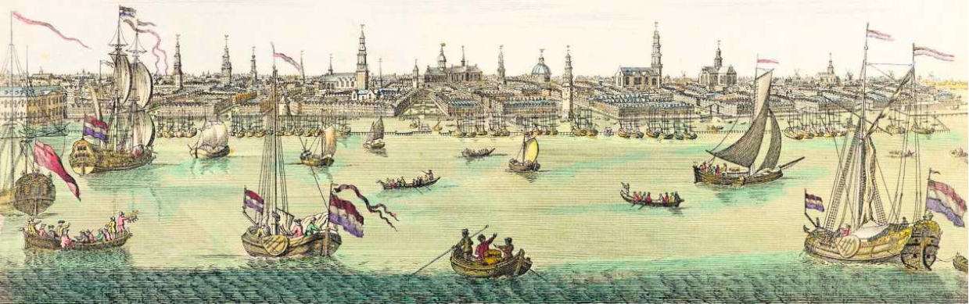
SMART CITIES
Fall Semester 2016, ETH Zürich
Gerhard Schmitt
http://static.nzz.ch/files/4/5/6/BamS_20161030_1.18775456.pdf

