Slide 1
SMART CITIES Fall Semester 2016, ETH Zürich Gerhard Schmitt

Slide 2
2 AC MvN: Smart Cities
3 GS: Urban Big Data
4 GS ET: Urban Measurement
5 GS: Urban Science
6 GS: Complexity Science
9 GS: Responsive Cities
Exercise 2: Urban Measurement
Exercise 1:
Smart Objects, Smart Buildings, Smart Cities
Citizen Design Science
Measurement and Simulation
Stocks and Flows in Urban Systems
Cognitive Design Computing
Participatory Design and Management
8 GS: Smart Livability
12 GS: Feedback Session
Objectives, Definition, MOOC
Smart Cities
10 GS: Smart Security
11 GS: Smart Mobility
1 GS ET: Introduction
7 GS: Smart Governance
Exercise 3:
Complexity Science
City Livability Rankings
Cyber Civil Infrastructure
Engaging Mobility
Next Steps

Slide 3
Content
Feedback on first Exercises
Marc van der Net: Now City and Future City
Discussion

Slide 4
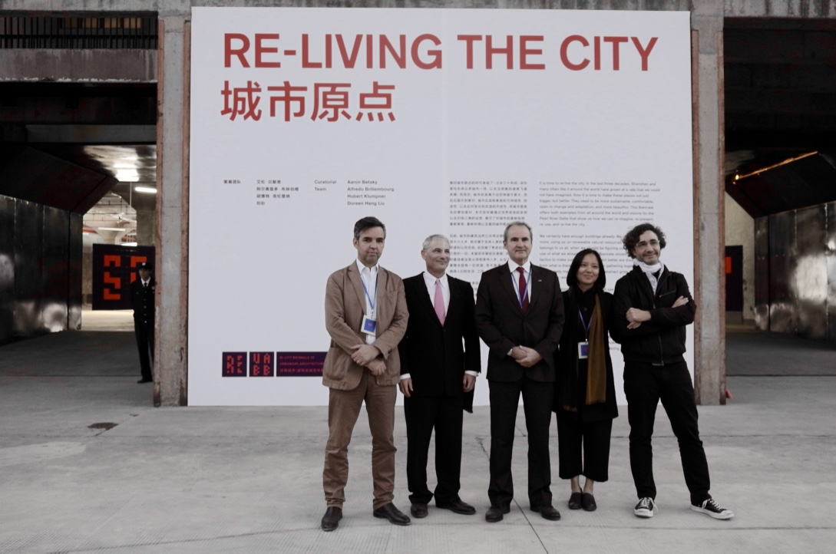

Slide 5
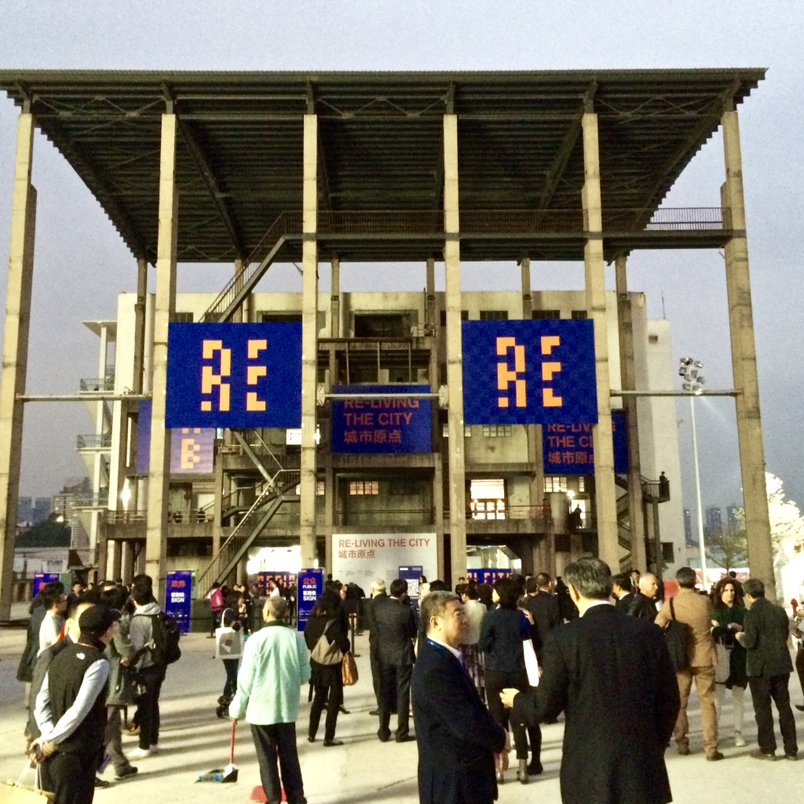

Slide 6
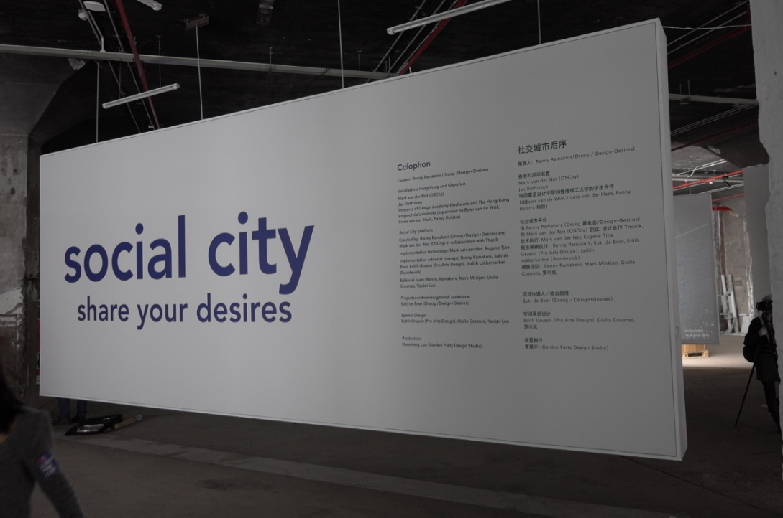

Slide 7
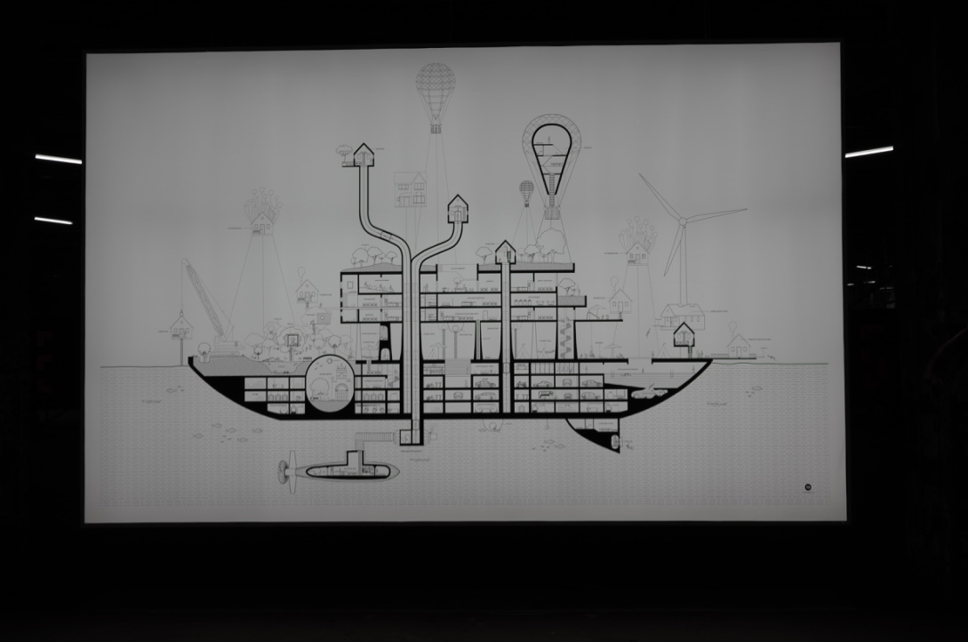

Slide 8
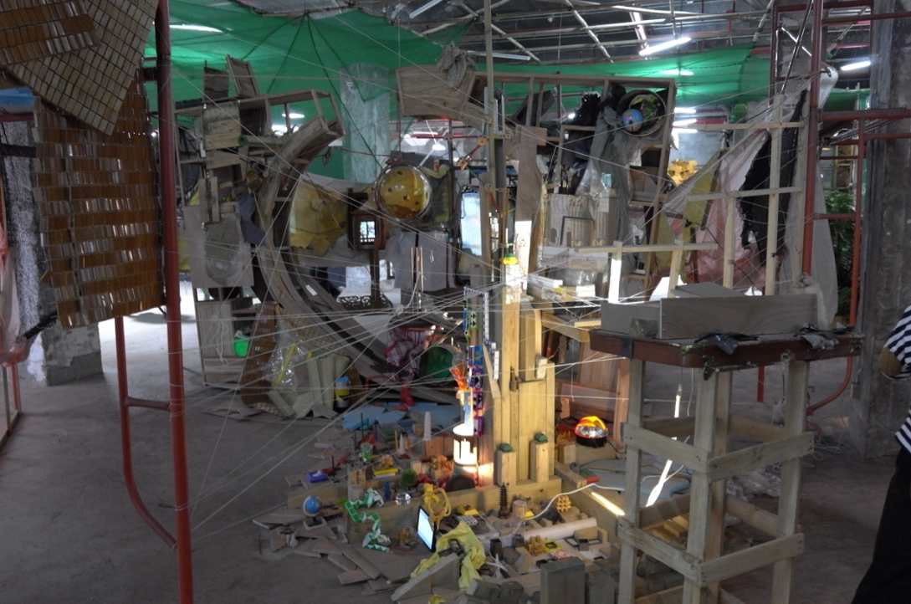

Slide 9
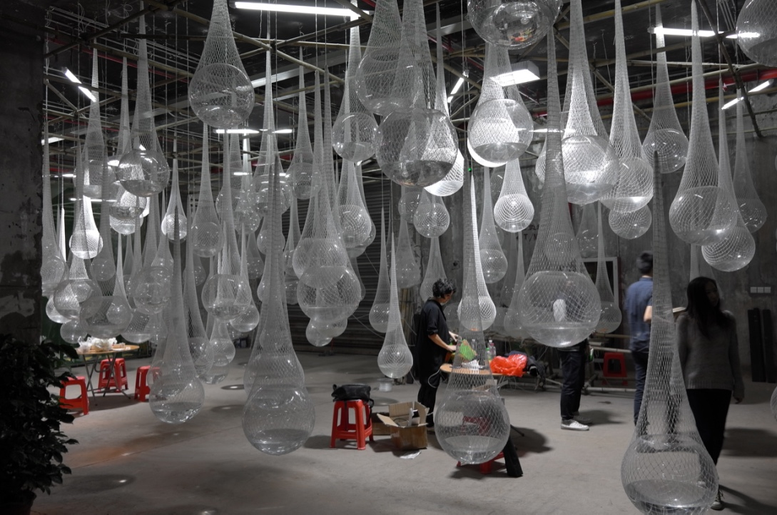

Slide 10
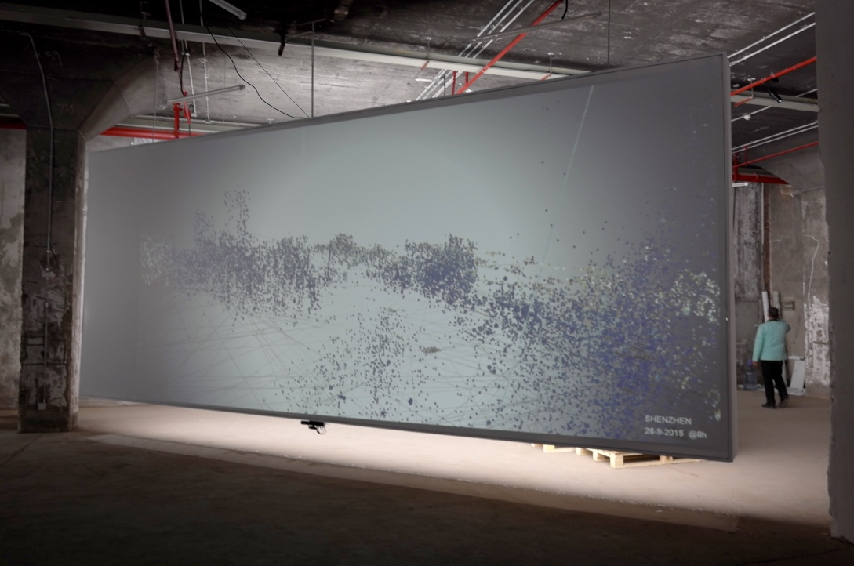

Slide 12
Mark van der Net (b. 1982) studied electrical engineering and architecture and urban planning at the Eindhoven University of Technology. He operates at the interface of technology and culture, exploring the ways in which science and technology challenge existing cultural structures while those structures in turn shape the development of technologies and science.
In 2013, Van der Net created the free online platform OSCity.nl with support from Het Nieuwe Instituut and the Creative Industries Fund NL. This open data platform invites everyone to discover the potential of cutting-edge information technology for serving the common good. What would happen if spatial planning worked more like the open-source movement? In answering this question, OSCity explores how we can generate value by sharing insights, designs, feedback and methods of optimisation.

Slide 13
